Slide 1
Software Configuration Management

Slide 2
Software Configuration Management
“Change Management” is one of the fundamental activities of software engineering.
This is because the business environments for which software applications are developed, themselves are very dynamic.
And business requirements , expectations from software applications keep changing.

Slide 3
Some definitions
Configuration: the arrangement of a computer system or components as defined by the number, nature and interconnections of its constituent parts.
Configuration Management: a discipline applying technical and administrative direction to: identify and document the functional and physical characteristics of a configuration item, and control changes to those characteristics, report change processing and implementation status and verify compliance with specified requirements.

Slide 4
Why Configuration Management?
Consider the following aspects:
Changes are frequent
Different customers have different requirements
Changes get clarified at a later date
Business Environment, too, changes
Technology changes
Personal whims!

Slide 5
Software projects: Personal turnover
Developers leave
Users change
Customer single point contact changes
Another problems are:
Double maintenance problems
Shared data
Simultaneous updates
Missing/unknown version problems

Slide 6
All this only means that change is inevitable when computer software is built.
And changes increases the level of confusion among software engineers.
When changes are not analyzed and documented before implementing then, confusion will result.
“the art of coordinating software development to minimize confusion is called Configuration Management. Configuration Management is the art of identifying, organizing and controlling modifications to the software being built by a programming team. The goal is to maximize productivity by minimizing mistakes… ”

Slide 7
SCM activities are developed to:
Identify change
Control change
Ensure that change is being properly implemented
Report changes to others who may have to do with it.
Configuration Management includes six point:
It is a Management discipline
It identifies the proposed or actual configuration of a system
This is done at discrete points in time.

Slide 8
Systematically records and traces changes to all system components
Provides tools for controlling changes; and finally
Allows everything happening with the system, throughout the entire life-cycle of the system, to be verified via auditing and reporting tools
Configuration Management is a process used for efficiently developing and maintaining software. This is accomplished by improving: accountability, reproducibility, traceability and co-ordination.

Slide 9
Nomenclature
System: the package of all the software that meet’s the user’s requirements.
Subsystem: large systems can have many subsystems, such as communication, display and processing.
Product: subsystems typically contain many products. Example an operating system might contain a control program, compilers, utilities and so forth.
Components: at the next level, a control program could be made up of such components of the sub-system.
Module: at the lowest level, components consist of a number of modules. Modules typically implement functions that are relatively small and self-contained.

Slide 10
SCM activities
SCM has four major activities:
Identification
Control
Status Accounting
Auditing

Slide 11
Software Configuration Identification
Configuration Identification: an element of Configuration Management, consisting of selecting the configuration items for a system and recording their functional and physical characteristics in technical documentation.
In addition to this, we must maintain:
Documentation
The specifications and designs
The test designs, data and reports
The change and problem reports
The ‘make’ files which direct and document the way the system is constructed.

Slide 12
Rules governing the process of SCI are:
SCI defines the ‘granularity’ of the SCM
SCI defines what is needed to be seen i.e. the visibility to all those who need to know what is happening on the project.
SCI ensures that the identification scheme selected reflects the structure of the product, the project and the organization.
The identification process must always be coupled with a parallel process of labeling the item with a distinct and unique label
SCI is a critical project management task.

Slide 13
SCI can be defined as work product or information that is created as part of the software engineering process.
Example of work products identified as configuration items:
Requirement specifications
Design specifications
Test plans and Test cases
Source code
Software tools
Software Configuration Management plans
Software verification and validations plan
User manuals

Slide 14
Software Configuration Identification
Important identification principles
Labels
Baselining
Partitioning a baseline is always subjective
Create some partition and maintain it
Baselines live forever
Relations v/s Versions
Visibility and Traceability
Configuration Identification numbering

Slide 15
Software configuration control
Configuration control: An element of configuration management, consisting of the evaluation, co-ordination, approval or disapproval and implementation of changes to configuration item after formal establishment of their configuration identification.
Software configuration control solves four of the most common problems facing software developers:

Slide 16
The double maintenance problem
The shared data problem
The simultaneous update problem
The missing/unknown version problem

Slide 17
Software configuration status accounting
Main issue of Software Configuration Management is acquisition and maintenance of all information concerning a project’s status and that of its parts.
For each configuration item, regardless of whether the item is an individual item or an aggregate, a separate ‘logical account’ is maintained and transactions are recorded.
In addition to transactions, actual programming information is recorded upon the configuration item’s archive.

Slide 18
Software configuration status accounting
Configuration Status Accounting Reports: there are three reports, which must be called the ‘most basic of reports’.
Transaction log
Change log
Item ‘delta’ report
Some other common reports are:
Resource usage
Stock status
Changes in progress
Deviation agreed upon etc.

Slide 19
Software configuration status accounting
Change control board: a group of people responsible for evaluating and approving/disapproving proposed changes to configuration items, and for implementation of approved changes.
CCB members are:
Project Managers
User Representative
Quality Controller
Configuration Controller

Slide 20
Change log
This log is implemented as an informal/formal notebook.
This log should contain all information relevant to, and regarding requested changes in the system or any part thereof.
The following minimum information is expected in the change log:
Change number
The change number will be assigned by the CCB
Change request status type
Request opened
Authorized for implementation
In implementation
In pre-release testing
Change request denied

Slide 21
Change request originator details
Software documents affected by this change request
Change request originator date
Change description
Details of the person who will carry out the Change Request when approved
Impact Analysis Details
Follow-up action required to implement this change request

Slide 22
Delta report
This report is generated to summarize progress of the development and to compare this progress with status presented in the previous report.
Report should include:
Dates
Narrative
format

Slide 23
Stock status report
This report should summarize the status of each and all system changes which are in a defined state of ‘open’; and should indicate the following items:
Inventory
Description
Status
Analyst/programmer/software engineer
Completion date

Slide 24
Transaction log
This report should clearly show the effect and relationships resulting from each and every event, which occurred during the course of the software project.
It should have the following minimum entries:
Transaction number
Date and time stamp
Originator
Software elements affected
Description of the activity
Change in progress report
Participants
Impact

Slide 25
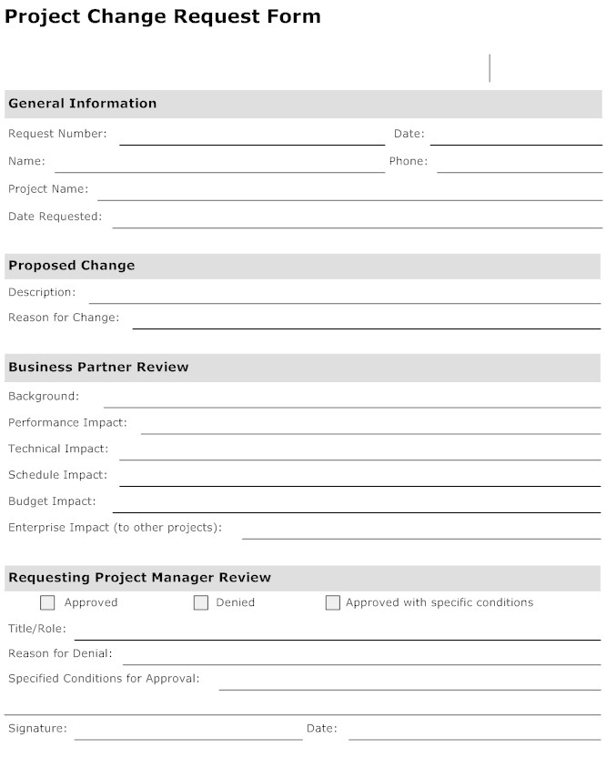

Slide 26
Configuration Auditing
A software configuration audit should periodically be performed to ensure that the SCM practices and procedures are rigorously followed.
Every major baseline must be audited. For in-house systems, an informal audit is usually sufficient.
The intention of audit is to provide project visibility.
Generally, configuration audit is performed by an external auditor.

Slide 27
Control over suppliers and subcontractors
It should be noted that the items or subsystems, which are developed by sub-contractor or supplied by vendor, must always be controlled and audited for Configuration Management.
The determination of sub-contractor Configuration Management requirements should be governed by a consistent concept of the needs of the agency issuing the contract.

Slide 28
Guidelines for Configuration Audits
SCM audits are periodically needs to ensure the integrity of the software baselines.
An audit is performed before every major baseline change or major release and non-conformances if any are tracked to closure and reported to all stake holders.
The configuration audit team consists of qualified technical people who are not involved in the specific tasks being audited.
The audit verifies that changes to the baseline are implemented as intended.
The auditing function is an integral part of the SCM system.

Slide 29
A phase review process then ensures that the proper actions are taken as follows:
Requirements
Functional
High-level design
Detailed design
Product
operational

Slide 30
Process Audit Checklist Process: Configuration Audits
Audit Criteria | Yes | No | N/A | Notes
Are process inputs used and the correct versions, where applicable? CM Plan, schedule Baseline documentation Baseline product Final test results
Is the configuration audits process performed when scheduled and when ready?
Is configuration verification performed of requirements and design baselines?
Are functional configuration audits performed of accepted product?
Are final physical configuration audits performed of completed product?
Does the configuration audits process comply with its defined documentation?
Are the correct outputs produced? Baseline configuration verification results and actions Functional configuration audit results Physical configuration audit results
Additional Notes:
QA: |  |  |  | Date:

Slide 31
Personnel in SCM Activities
Number of personnel
Expected skills levels
Job titles
Security clearances needed.

Slide 32
SCM: Some pitfalls
Anti-patterns are the syndromes to be watched for:
Silver Bullet
Developer-software configuration management
Failure to audit
Software configuration management experts
Postmortem planning

